Slide 1
Salt identification
Group member:
minda Chen
yuxuan xiong

Slide 2
Background
Objective
Build a salt identifier to automatically mark the location correspond to salt in seismic images.
There are several areas of the world where there are vast quantities of salt in the subsurface. But unfortunately, knowing where large salt deposits are precisely is very difficult. Professional seismic imaging still requires expert human interpretation of salt bodies. This leads to very subjective, highly variable renderings. More alarmingly, it leads to potentially dangerous situations for oil and gas company drillers.

Slide 3
Use case
Use case 1:
Actor: Administrator
Action: Ingest/preprocess training images and train/save/evaluate the model
Use case 2:
Actor: Seismologist
Action: Load images then run against the model to know where salts are located

Slide 4
Main tool : DeepLearning4J library
 | Scala | DL4J
Use case 1 | Ingest training set Preprocess input | Train Save Evaluate
Use case 2 | Load image Preprocess input Decode output | Run against model

Slide 5
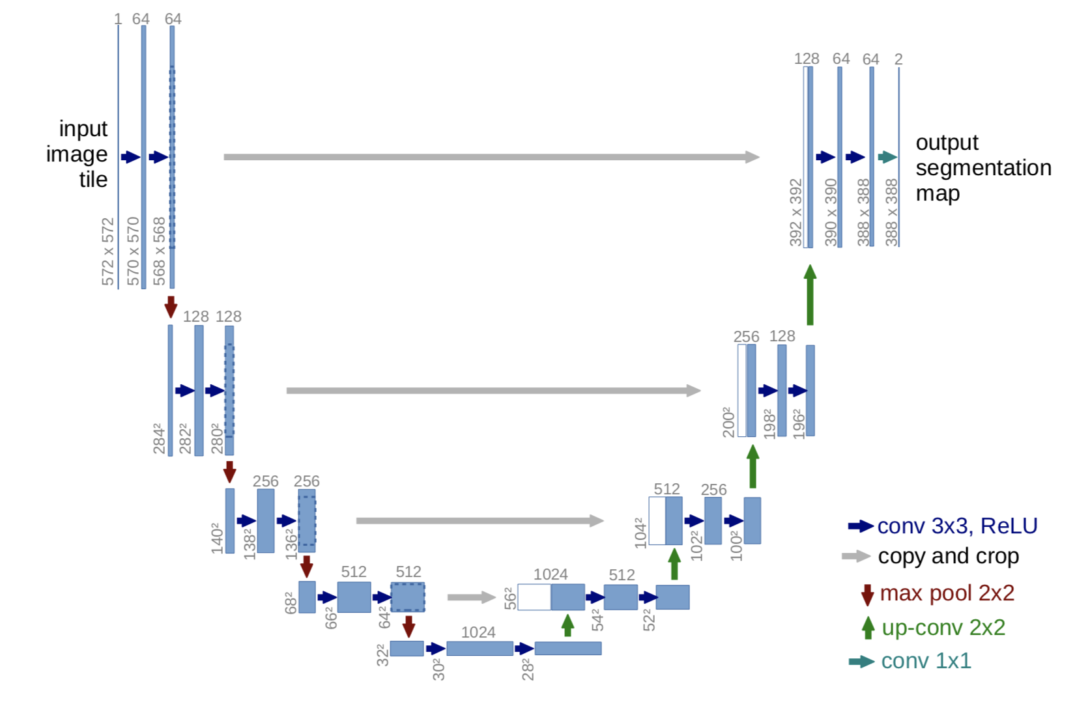
Methodology
Convolutional Neural Network (CNN)
U-net

Slide 6
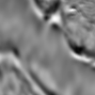

Methodology
Input:
Output:
Seismic reflection images of subsurface containing salt and regular rocks
Reflection Masks that mark out the salt in input images

Slide 7
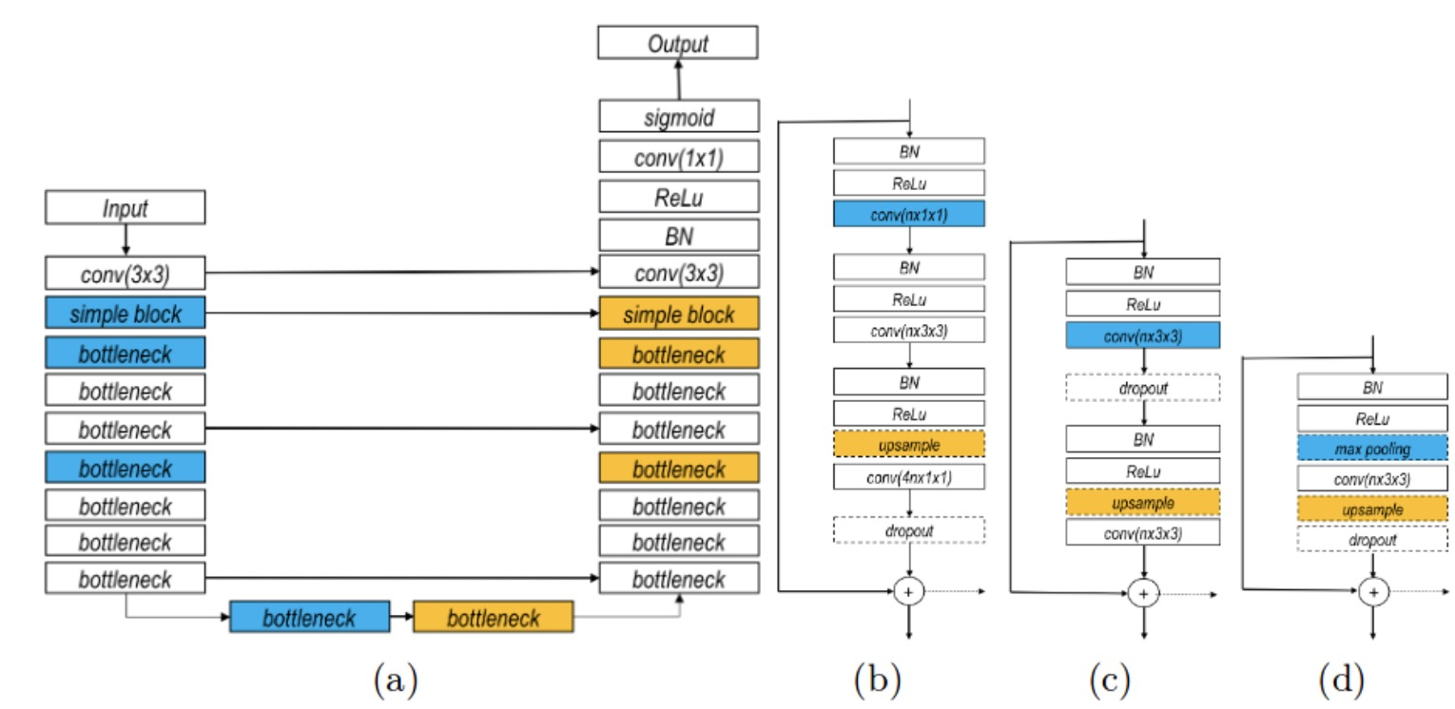
Methodology
U-net with residual blocks
Residual U-net
Bottleneck Block
(c) Basic Block
(d) Simple Block

Slide 8
Data magnitude
Train set: 4000
Test set: 18000
Image size: 101x101x1

Slide 9
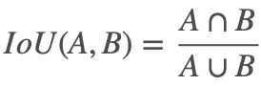
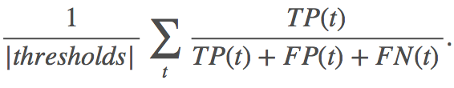
Evaluation
The IoU of a proposed set of object pixels and a set of true object pixels is calculated as:
The metric sweeps over a range of IoU thresholds, at each point calculating an average precision value. The threshold values range from 0.5 to 0.95 with a step size of 0.05: (0.5, 0.55, 0.6, 0.65, 0.7, 0.75, 0.8, 0.85, 0.9, 0.95). In other words, at a threshold of 0.5, a predicted object is considered a "hit" if its intersection over union with a ground truth object is greater than 0.5. At each threshold value t, a precision value is calculated based on the number of true positives (TP), false negatives (FN), and false positives (FP) resulting from comparing the predicted object to all ground truth objects:

Slide 10
Acceptance criteria
Our goal:
Average IoU > 80%

Slide 11
Milestones
1st week: Nail down the topic and assign works
2nd week: build a primitive model
3rd-4th week: fine tuning the model to reach the goal
5th week: clean and wrap up the project, prepare for the presentation

